Slide 1
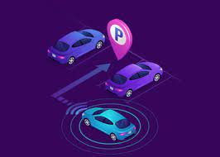

SRI SHANMUGHA COLLEGE OF ENGINEERING AND TECHNOLOGY Department of Biomedical Engineering
SMART PARKING SYSTEM
Present by 3rd year S. Swetha- (732721121055) M. Sindhu - (732721121046) T. Srimathi- (732721121051) C. Chanthruba- (732721121007)
R.Bharathi- (732721121006)

Slide 2
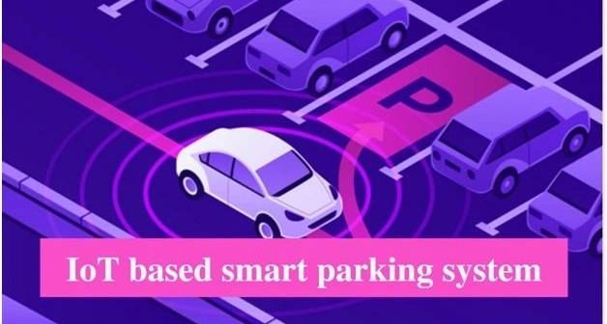
Outline…
Introduction
Project motivations
System methodology and flowchart
System main components
Block diagram
SWOT Analysis
Conclusion
Future work

Slide 3
Introduction…
The goal of parking system project is to reserve parking spot for a car/vehicle before it arrives. One of the most problems that the driver faces is finding a free parking spot, so many driver stopping their cars at the edges of the street. Therefore, we choose this to prevent the frustration of finding a parking spot and they can reserve a spot when they stay at home. It is an IOT based project.
Project Motivations…
Save time
Reduce fuel consumption.
User friendly system.
Controllable system
Become more important in the urban crisis
Make a smart city and climbed for the best.

Slide 4
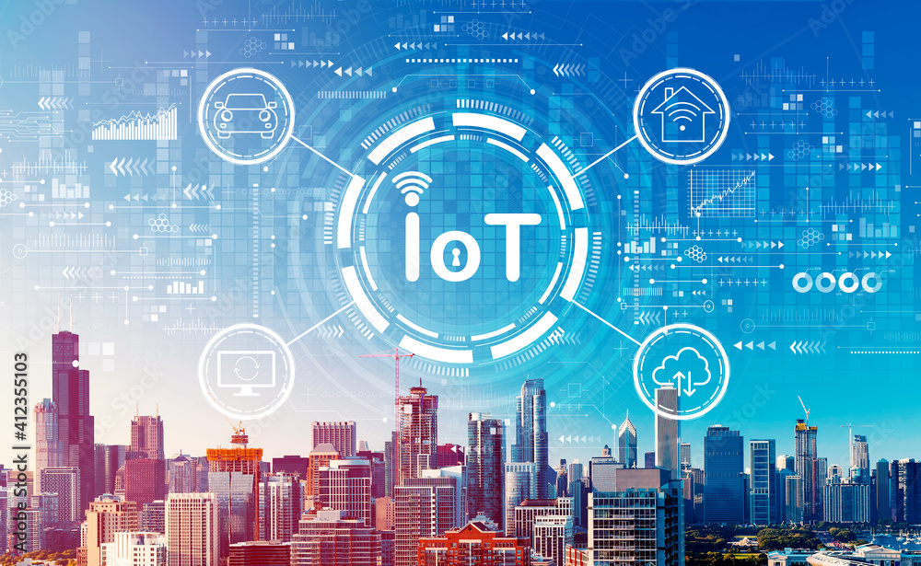
What is an IOT?
The Internet of Things (IOT) is the network of physical objects or things embedded with electronics , software, sensors and network connectivity which enables these objects to collect and exchange data.

Slide 5
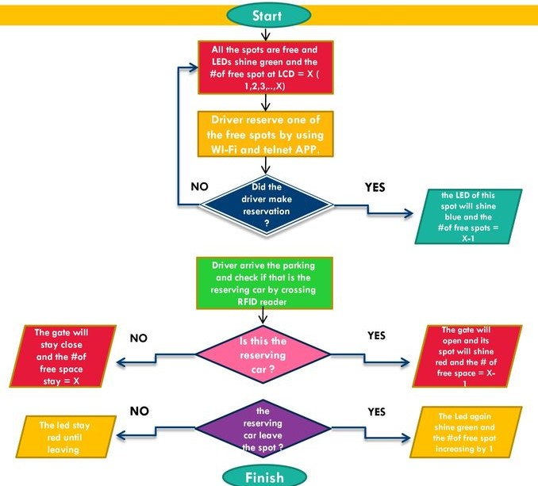
System Methodology and Flowchart…

Slide 6
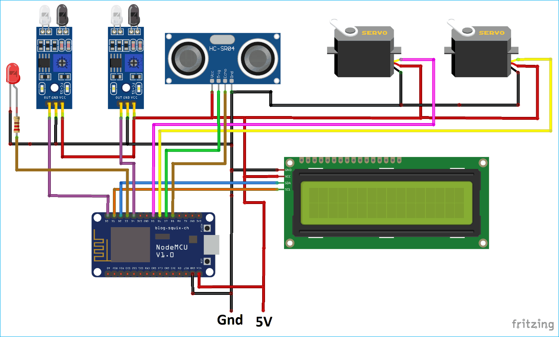
System Main components…
Arduino MEGA
Ultrasonic sensor
IR Sensors
LCD(Liquid Crystal Display)
Jumpers
RFID Reader(Radio frequency identification)
Servo motor
ESP8266 Serial Wi-Fi module
Red, Green, Blue LED’s
Telnet application

Slide 7
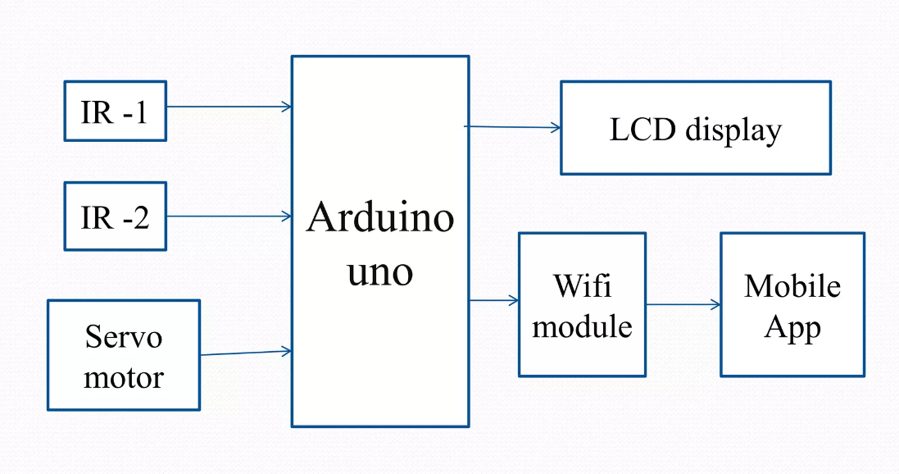
Block diagram…

Slide 8
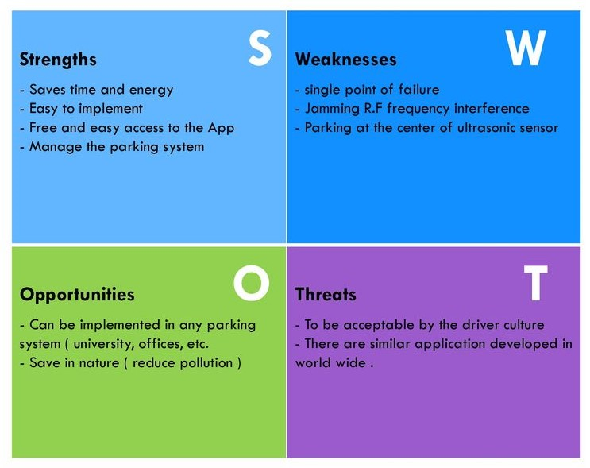
SWOT Analysis…

Slide 9
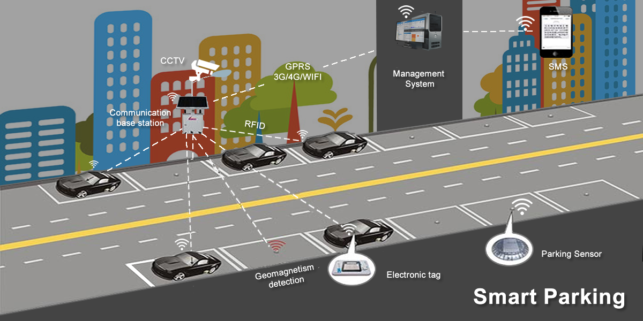
Conclusion…
Reliable , well functioning system model for smart parking system.
This also be implemented in Shopping malls, theatres, restaurants etc..
The system benefits of smart parking go well beyond avoiding time wasting.
Developing a smart parking solutions within a city solves the pollution problem.
Future work…
The future of the smart parking system is expected to be significantly influenced by the arrival of automated vehicles (Avs). Several cities around the world are already beginning to trial self-parking vehicles, specialized AV parking lots and robotic parking valets.
Add more features as SMS notifications or remote communication. Add more features to the Telnet program to help drivers.

Slide 10
THANKYOU…

